Slide 1
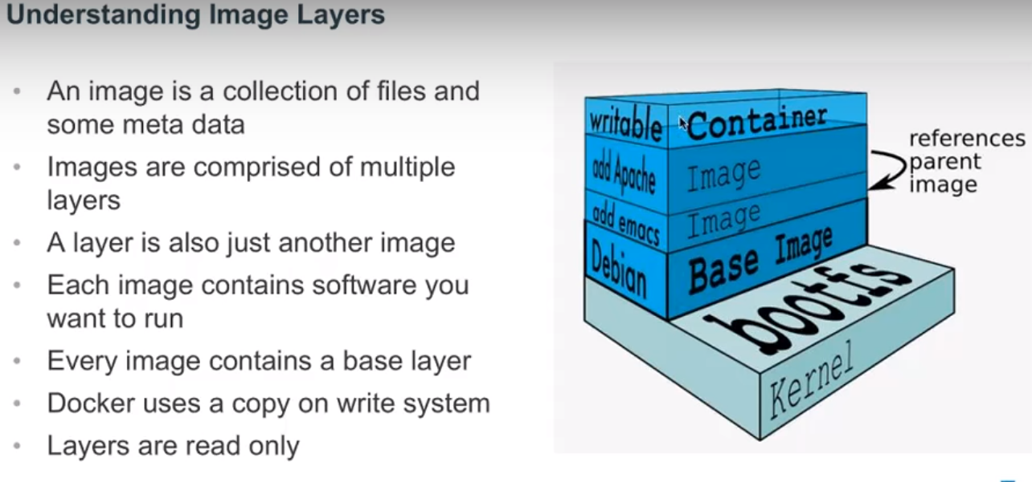
DOCKER
From docker.com

Slide 2
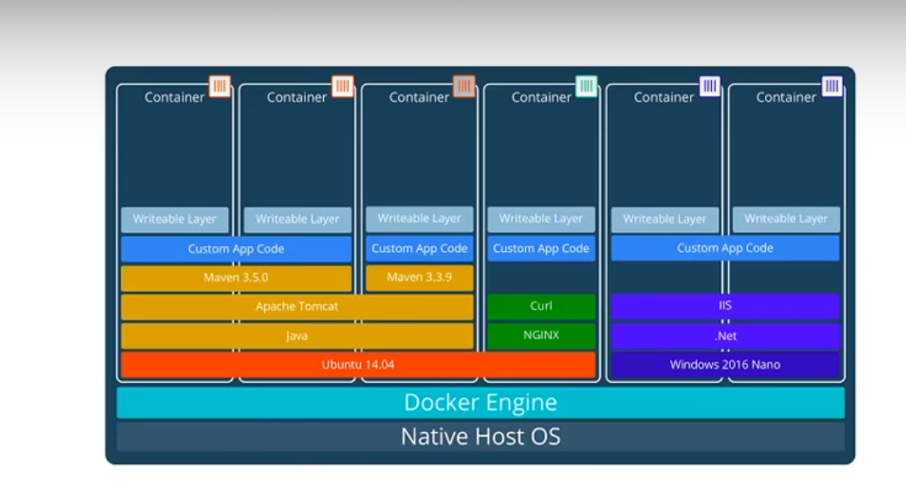
layers
From docker.com

Slide 3
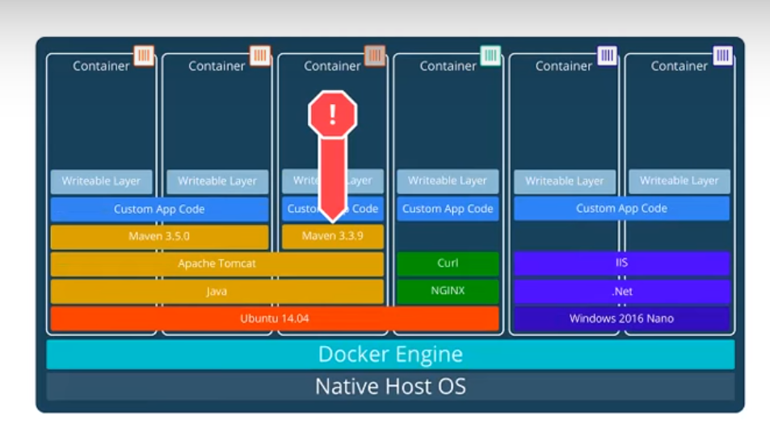
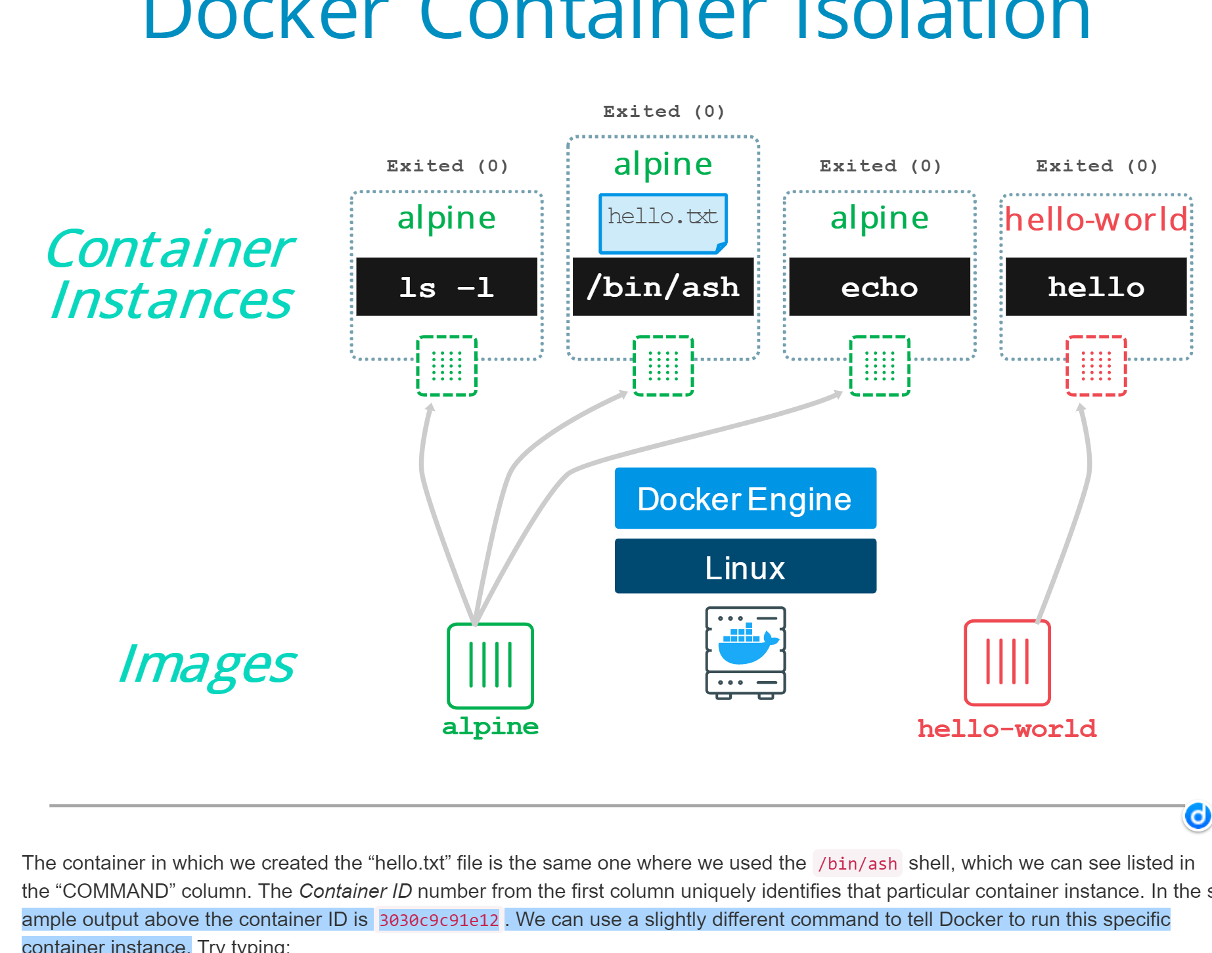
Isolation
Sperate file systems
Both from docker.com

Slide 4
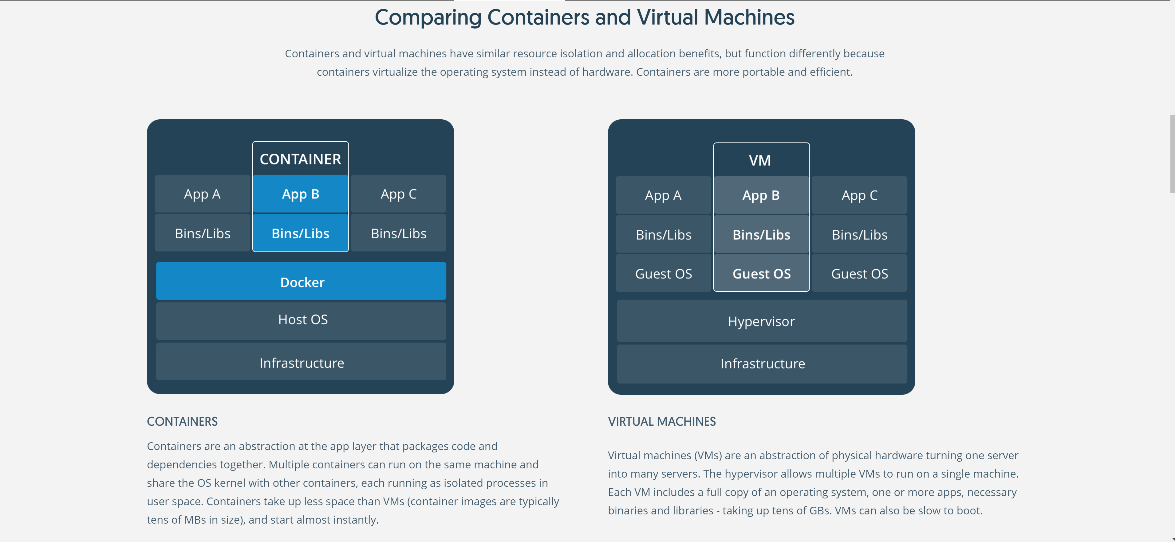
Abstraction at the app layer
Containers sharing the same OS
Abstraction of physical hardware,
one server into many servers.
A full copy of OS, mamy apps for each.

Slide 5
benefits
Developing environment for Multiple APPS, taking less space than VM
Easy to for new people to get on board , no more ”working on my machine”
One down, others not affected
Secure and easy to manage

Slide 6
Functions and Computation
In Mathematica, everything is a function.
Is everything a function?
Correspondence between a collection of possible input values and a collection of output values so that each possible input is assigned a unique output.
Computable and uncomputable.

Slide 7
A Noncomputable Function
The halting problem.
Self-reference

